Slide 1
Heart Attack Analysis & Prediction

Slide 2
The Problem
Using some indicators to predict the risk of Heart attack.

Slide 3
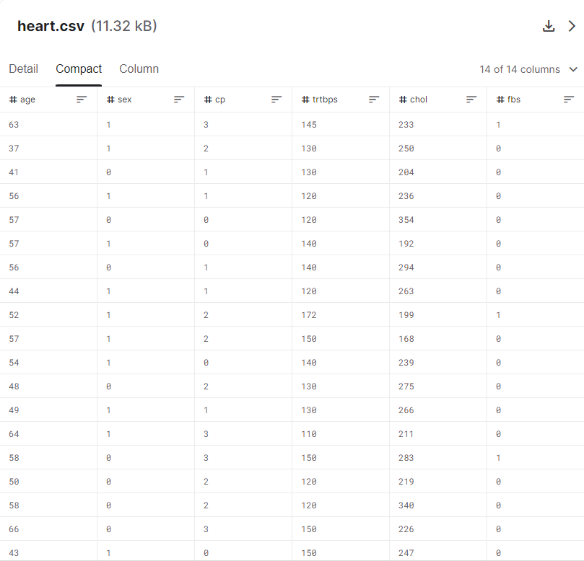
Data Source
Data Source:
Kaggle: https://www.kaggle.com/datasets/rashikrahmanpritom/heart-attack-analysis-prediction-dataset

Slide 4
Data Wrangling
There is no need to do Data Wrangling, because the dataset is well organized and clean
The only small thing needs to do is to group the age into groups for EDA

Slide 5
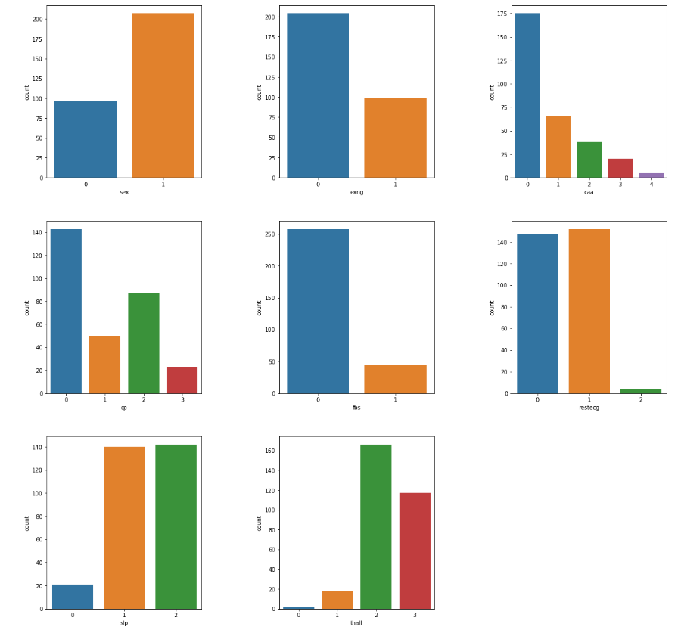
EDA

Slide 6
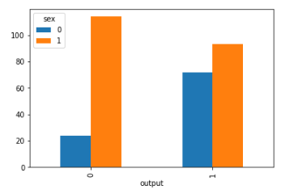
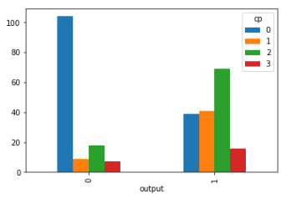
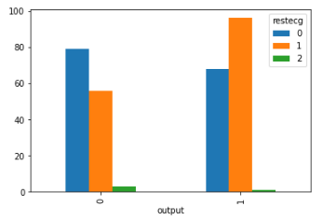
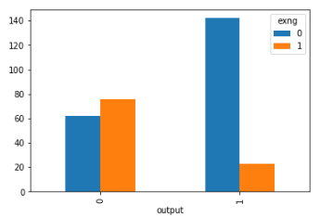
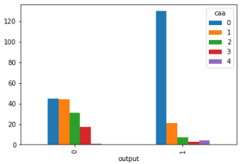
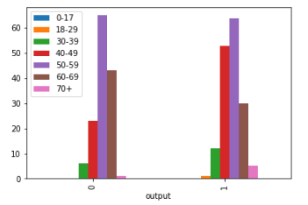
EDA (Continued..)

Slide 7
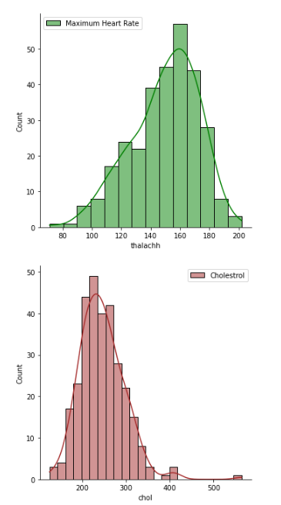
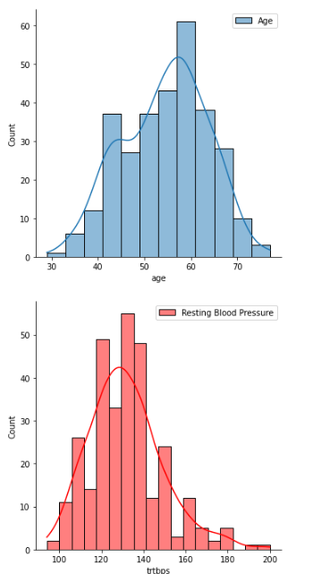
EDA (Continued..)

Slide 8
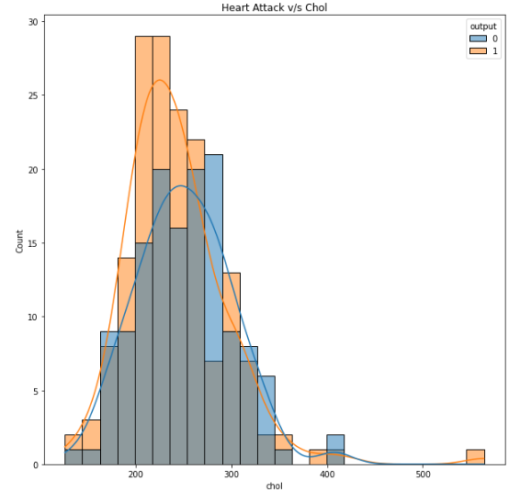
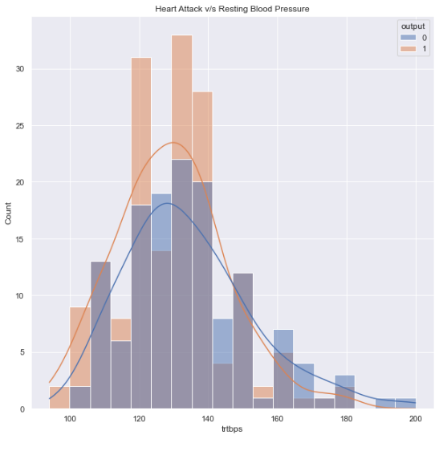
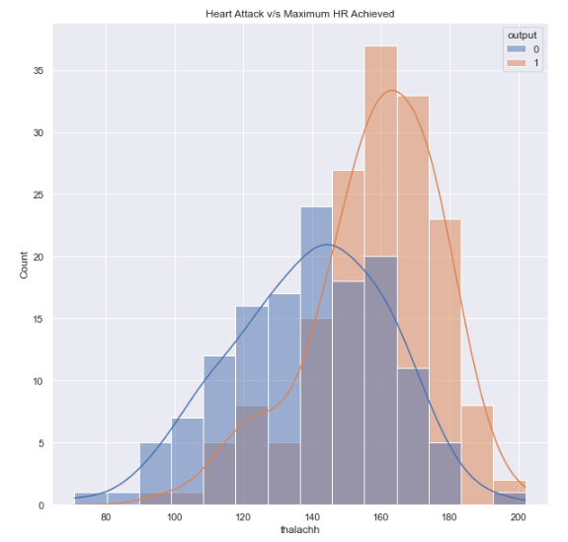
EDA (Continued..)

Slide 9
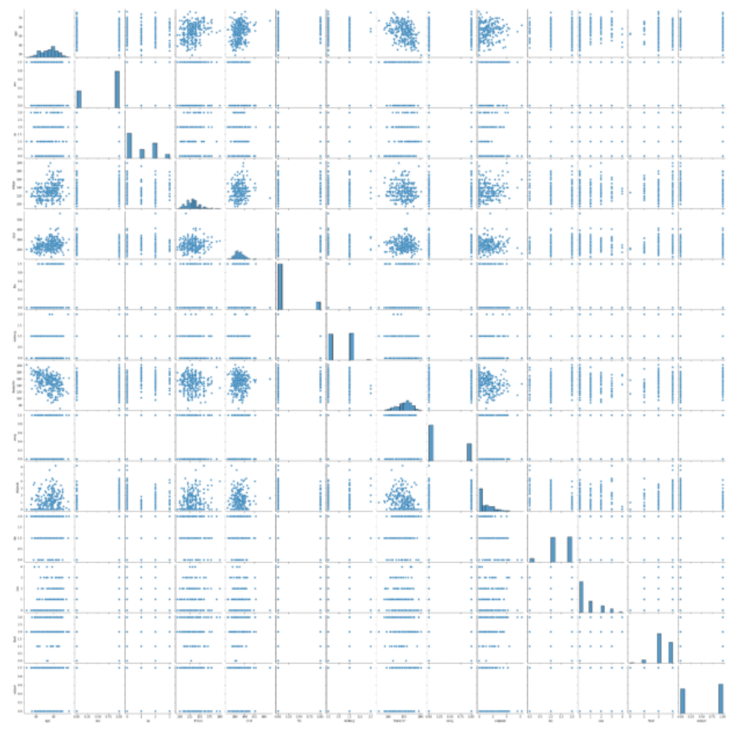
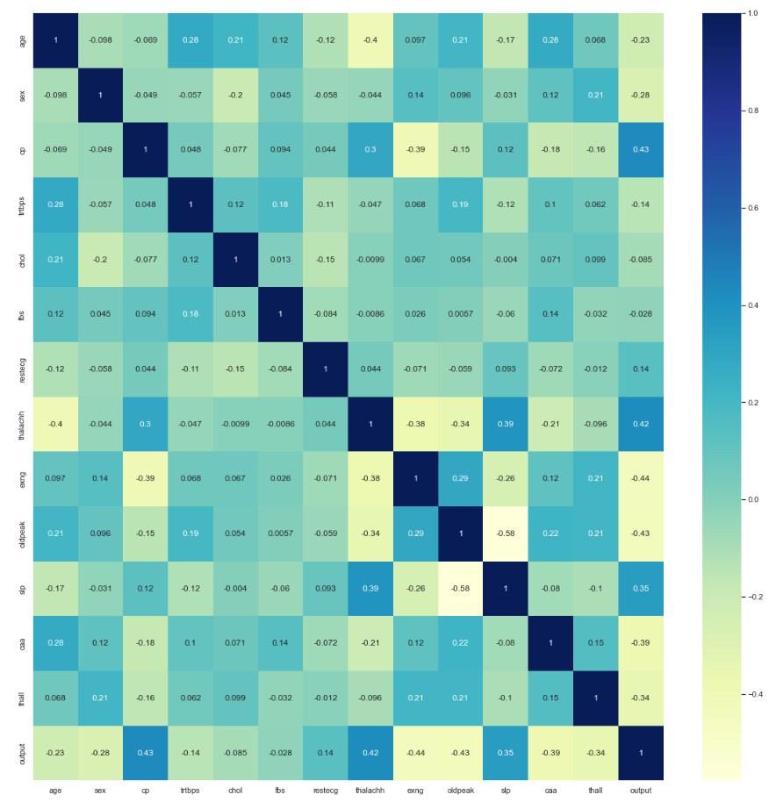
EDA (Continued..)

Slide 10
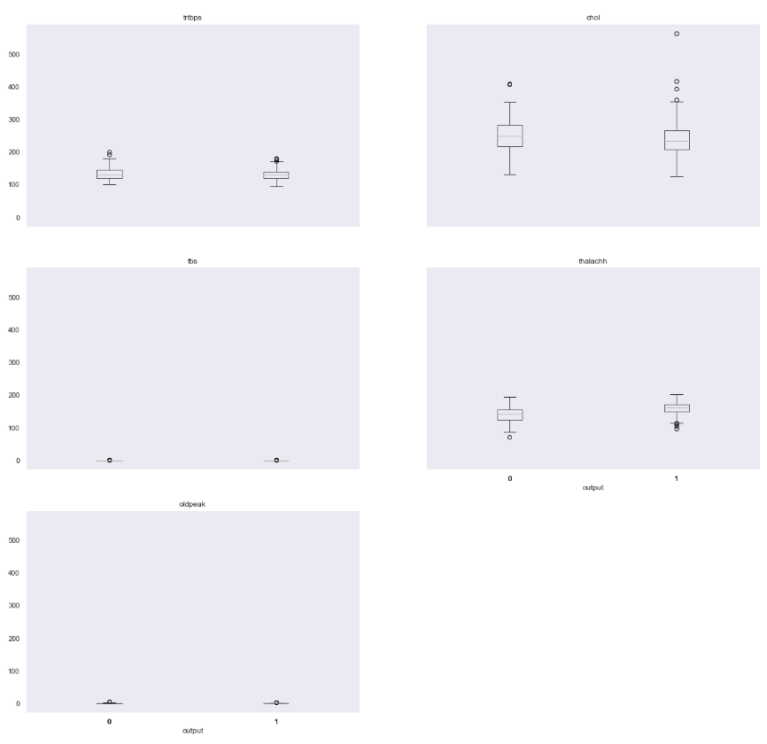
EDA (Continued..)

Slide 11
Conclusion
SVC has higher AUC
Choose Logistic Regression as best model, because it has the highest Accuracy Score and pretty good AUC
 | Accuracy Score | AUC
Logistic Regression | 0.824 | 0.899
Gradient Boosting | 0.81 | 0.875
SVC | 0.802 | 0.922

